Slide 1

Covid Viz-Hub
Group 10 Members:
Jacob Celestine (jc277)
Nisha Kumari (nk755)
Sihao Sun (ss3665)

Slide 2
Why this dataset?
The economic and social disruption caused by the pandemic is devastating: tens of millions of people are at risk of falling into extreme poverty, while the number of undernourished people are currently estimated at nearly 690 million.
We need ways to help people assess the risks involved, and understand what is happening around them. This would help them to take better, informed decisions.
Dashboards has become the iconic interface through which we understand the coronavirus pandemic. These visual displays are supposed to give us the information we need to act.
According to WHO, as of December 2020, COVID-19 had infected over 82M people and killed more than 3M worldwide.

Slide 3
Dataset Description
Sources: Time Series Data by JHU Case Surveillance Data by CDC
Size of CDC data: 5.82 GB in total; 430 KB/record Size of JHU data: 18.1 MB in total; 30.8 KB/record
Number of records being processed: 44.1M

Slide 4
Fundamental QUESTIONS
CDC Dataset | JHU Dataset
19 Columns | 11 fixed columns + Date columns
2 Quantitative fields | 5 Quantitative fields
17 Plain text fields | 6 Plain text fields
Updated every 2 weeks | Updated daily
Each row is a deidentified patient case | Each row shows changes to a country/ state per day.
Cross-sectional data | Time-series data

Slide 5
Dataset Snippet
CDC data:
JHU data:

Slide 6
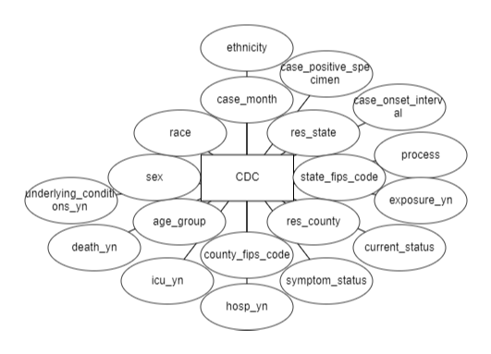
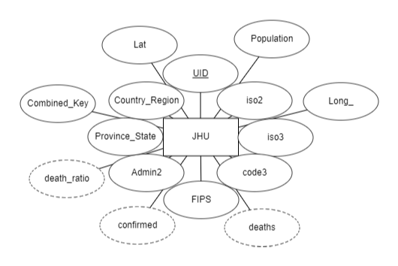
Entity Relationship Diagram

Slide 7
Expected Target Users
Common People: To visualize and gain key insights to the spreading of the virus.
State & Federal Governments: To facilitate containment actions, planning or any public health measure that contributes to fighting the COVID-19 pandemic in the state or beyond if requested.
Local Businesses: To analyse the trend and take appropriate decisions.
Hospitals & Health Workers: As the people treating COVID patients, they need to kept updated about the trends and patterns happening around them.

Slide 8
Data Insights and Interesting Findings Expected
World level:
Deaths due to coronavirus across the world across the days of the year?
Spread of coronavirus across the world across the days of the year?
Recovery rate of Coronavirus across the world across the days of the year?
US level:
Deaths due to coronavirus across the US across the days of the year?
What percentage of people in each state died in the US?
In the states with more than 1% deaths, what was the distribution in their provinces?
Individual level:
Which race has the most deaths?
Which gender has the most deaths?
Was underlying condition a major factor in the deaths occurred?
Which age group has the most deaths?

Slide 9
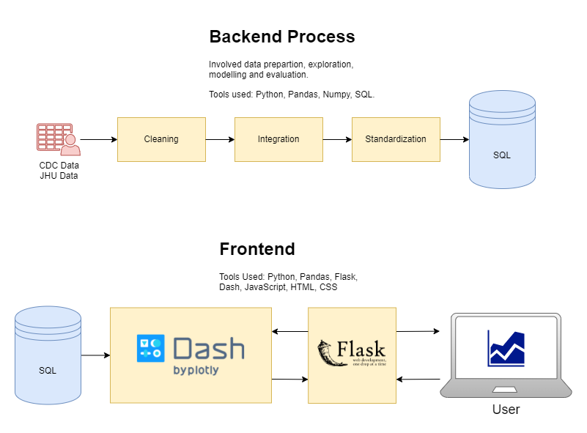
Conceptual Flowchart

Slide 10
Mode of Processing & Software Tools
Batch Processing of both CDC and JHU data.
Python: An interpreted high-level general-purpose programming language.
Plotly: Provides online graphing, analytics, and statistics tools for individuals and collaboration, as well as scientific graphing libraries for Python, R, MATLAB, Perl, Julia, Arduino, and REST.
Pandas: A fast, powerful, flexible and easy to use open source data analysis and manipulation tool, built on top of the Python programming language.
Flask: A web framework and Python module that lets you develop web applications easily.
JavaScript: High-level, often just-in-time compiled, and multi-paradigm programming language.
HTML and CSS: Used to construct and style the frontend.
SQL: A standardized programming language that is used to manage relational databases and perform various operations on the data in them.

Slide 11

Prototype Demo

Slide 12
Interactivity FEATURES
Allows users to interact with graphs on display, allowing for a better storytelling experience.
Supports various interactive features such as:
Zooming in and out
Point value display
Panning graphs
Animations for time series data.
Visiting data at a specific time period.

Slide 13
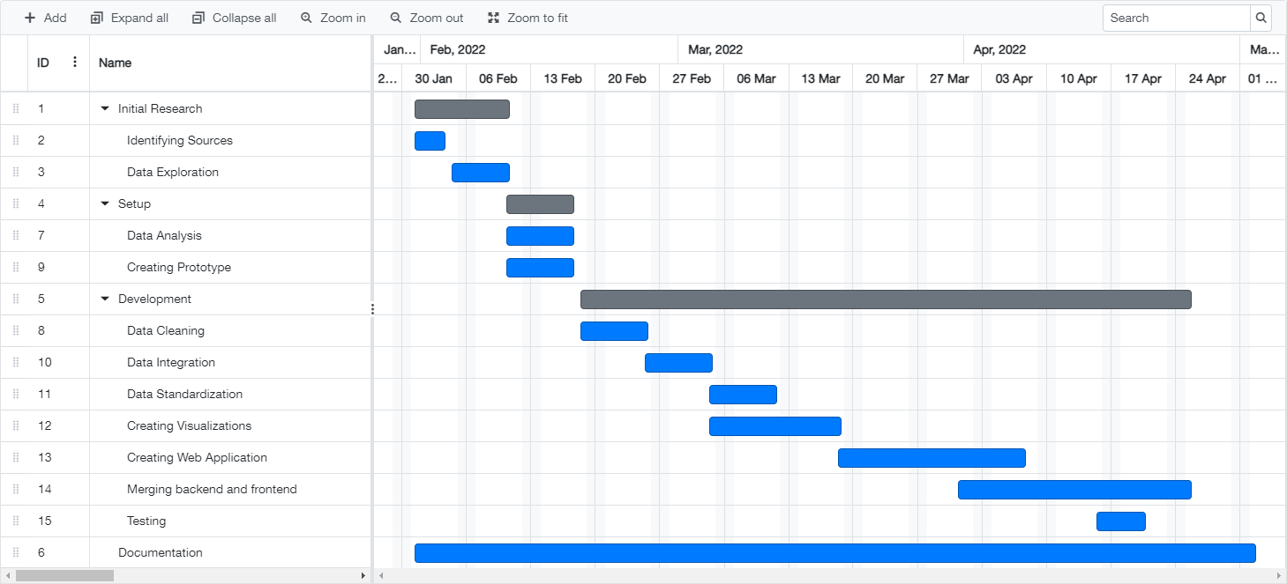
Gantt Chart

Slide 14
References
https://plotly.com/
https://pandas.pydata.org/
https://en.wikipedia.org/wiki/SQL
https://flask.palletsprojects.com/en/2.0.x/
https://github.com/CSSEGISandData/COVID-19
https://data.cdc.gov/Case-Surveillance/COVID-19-Case-Surveillance-Public-Use-Data-with-Ge/n8mc-b4w4

